Slide 1
Digital Portfolio
STUDENT NAME: N.SUREKA
REGISTER NO & NMID: 2422k1271/B19F24319FD9CFEA9A54ADF7CB378
DEPARTMENT: COMPUTER SCIENCE
COLLEGE/ UNIVERSITY: MAHARANI ARTS AND SCIENCE COLLEGE/ BHARATHIYAR UNIVERSITY

Slide 2
PROJECT TITLE:
“Interactive Personal Portfolio Website with Dynamic Animations and Responsive Design”

Slide 3
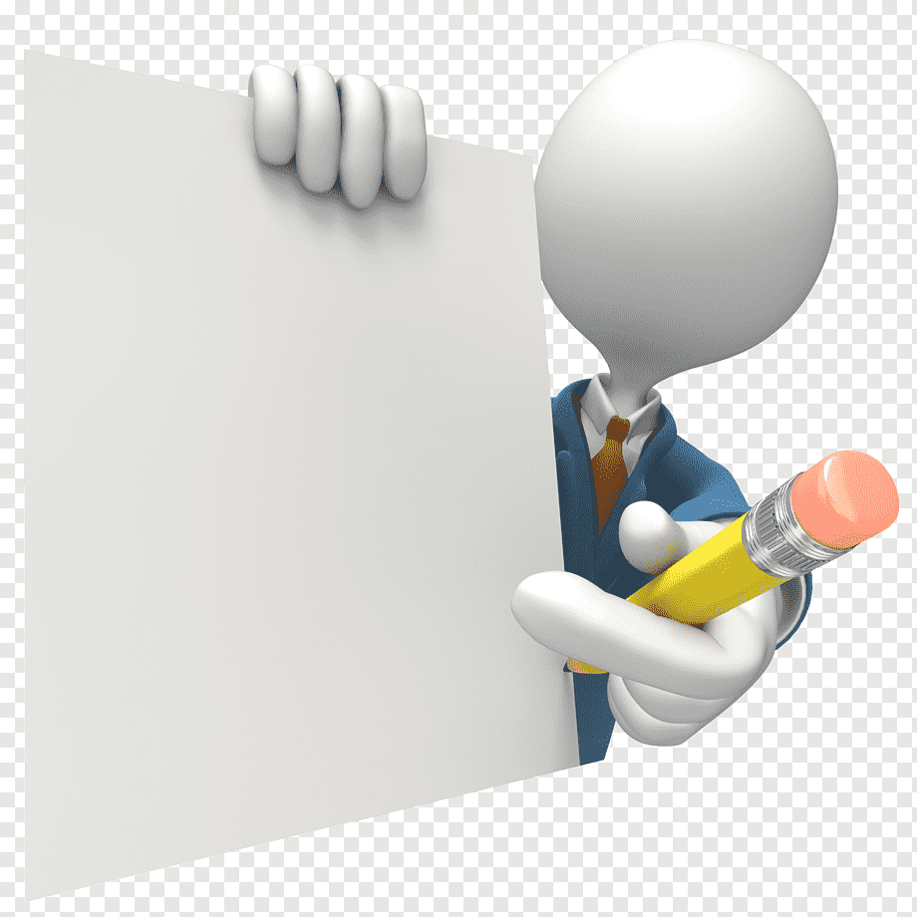
AGENDA
Problem Statement
Project Overview
End Users
Tools and Technologies
Portfolio design and Layout
Features and Functionality
Results and Screenshots
Conclusion
Github Link

Slide 4

PROBLEM STATEMENT:
In today’s digital world, personal branding and online presence are essential for professionals, especially for students and freelancers. Traditional static resumes and portfolios often fail to engage visitors or showcase skills effectively.
There is a need for an interactive, responsive, and visually appealing portfolio website that not only presents personal information, skills, projects, and achievements but also incorporates dynamic animations, smooth navigation, and user-friendly interactions to enhance user experience and make the portfolio stand out.
The challenge is to design and develop a web application that: Works seamlessly across all devices (desktop, tablet, mobile)
Allows visitors to easily navigate through sections like About, Skills, Projects,
Achievements, Reflections, Goals, and Contact
Includes interactive elements like animated skill counters, project hover effects, scroll- based animations, and a responsive navigation menu
Provides a professional and modern design that effectively highlights the individual’s
technical and soft skills

Slide 5
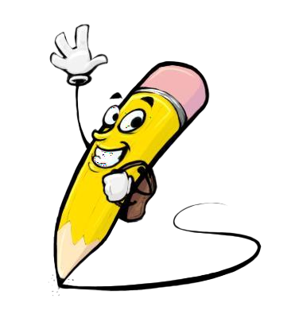
PROJECT
OVERVIEW:
This project is an Interactive Personal Portfolio Website that showcases an
individual’s skills, projects, achievements, and contact information. It features a modern design, smooth scrolling, responsive layout, and animated sections
to create an engaging user experience.
Key highlights:
Hero section with profile and introduction
Skills and projects displayed with interactive cards Achievements, reflections, and goals sections Functional contact form with validation
Responsive design for all devices and smooth animations
The website provides a professional online presence, making it
easy to showcase work and connect with others.

Slide 6

WHO ARE THE END USERS?
The end users of this project are:
Potential Employers or Recruiters – to evaluate skills, projects, and achievements.
Clients or Collaborators – to see previous work and contact for opportunities.
Peers or Students – for inspiration or to explore shared skills and projects.
General Visitors – anyone interested in learning about the individual’s
professional profile.

Slide 7

TOOLS AND TECHNIQUES
Tools:
HTML, CSS, JavaScript
VS Code (or any code editor) Browser Developer Tools
Icons/Fonts (like Font Awesome, Google Fonts) Techniques:
Responsive Design (works on all devices) Smooth Scrolling
Animations on scroll (Intersection Observer)
Form Validation
Hover and transition effects Grid and Flexbox layouts

Slide 8
PORTFOLIO DESIGN AND LAYOUT:
Header: Fixed navbar with smooth scrolling and mobile menu.
Hero: Introduction with name, role, and profile image.
About/Skills: Short bio, stats, technical and soft skills in grids.
Projects: Cards with project details and technologies used.
Achievements/Goals: Cards for awards and future goals.
Contact/Footer: Contact form, info, and simple footer with page counter.

Slide 9
FEATURES AND FUNCTIONALITY
Responsive Design: Works on desktop, tablet, and mobile.
Navigation: Fixed navbar with smooth scrolling and active link highlighting.
Hero Section: Typing effect on title and profile introduction.
Skills & Stats: Animated counters and hover effects.
Projects & Achievements: Interactive cards with hover animations.
Contact Form: Validation, send animation, and reset functionality.
Scroll Animations: Elements fade in and slide up on scroll.
Page Counter: Displays current section/page.
Mobile Menu: Hamburger menu for small screens.

Slide 10
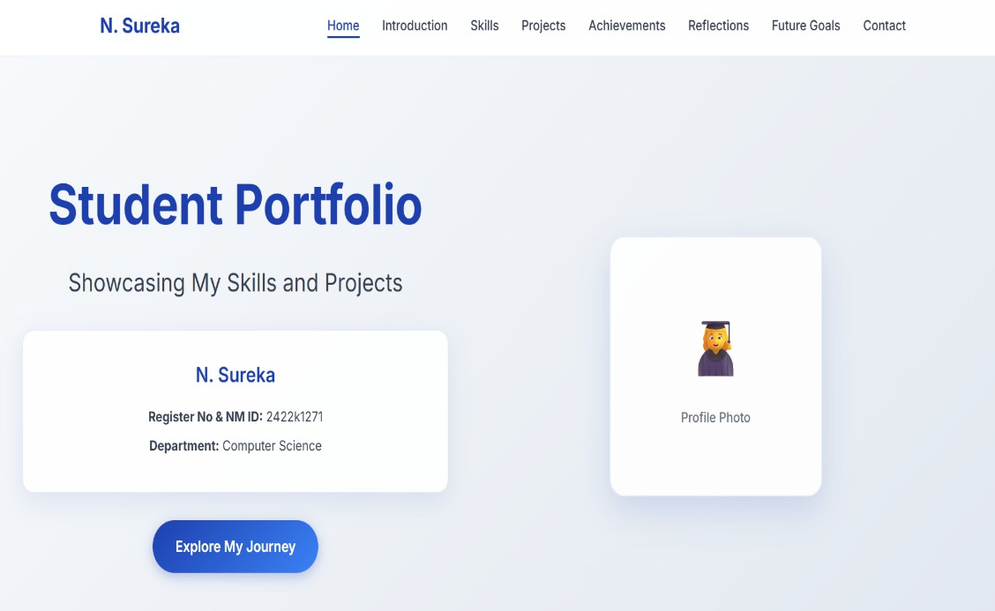
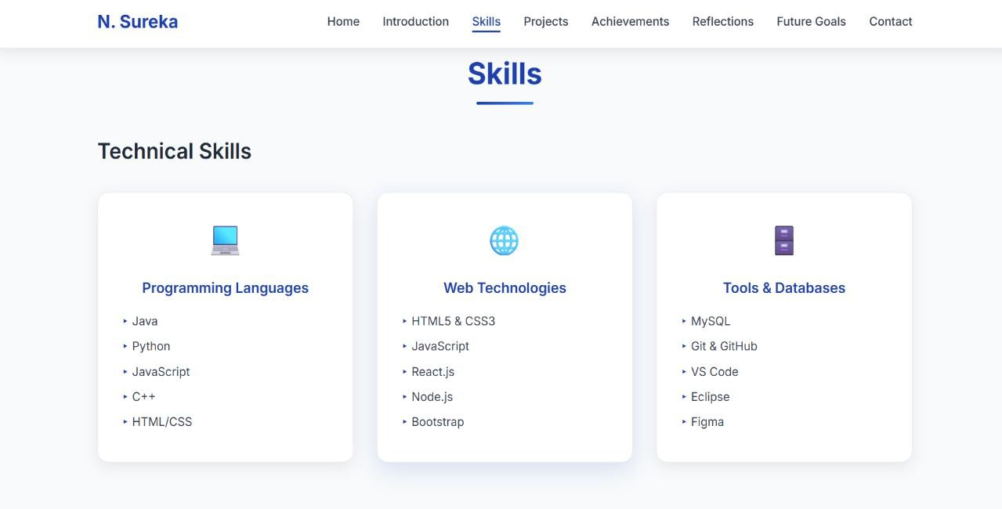

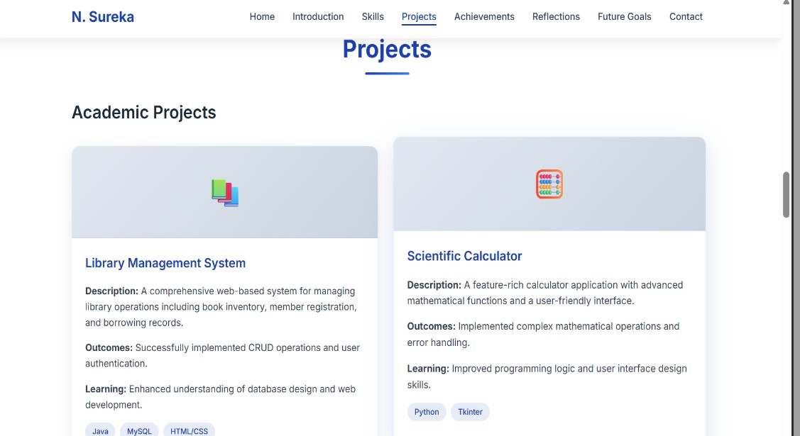
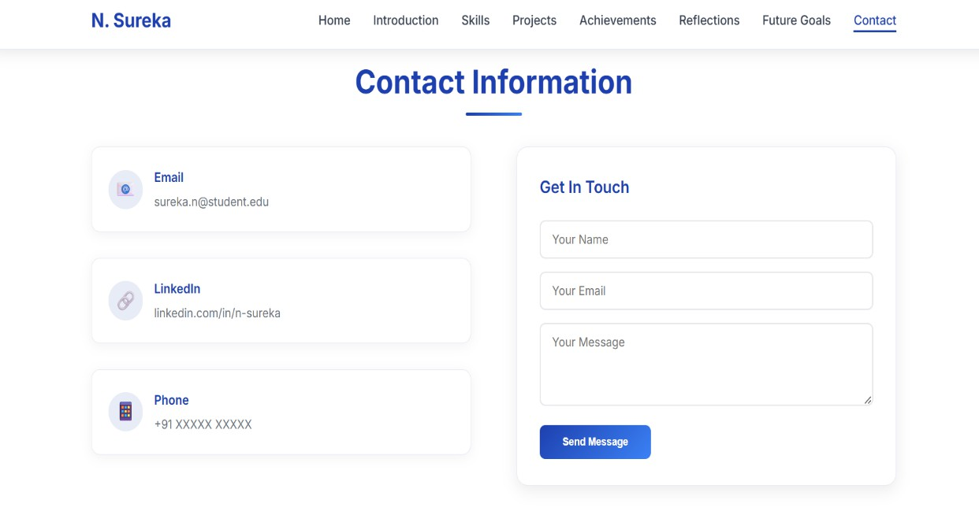
RESULT&SCREENSHOTS:
3/21/2024 Annual Review

Slide 11
CONCLUSION:
This portfolio reflects my academic journey, skills, and personal growth. It highlights my achievements, the challenges I have overcome, and the knowledge I have applied in practical ways. By showcasing my projects and experiences, it demonstrates my strengths in learning, problem-solving, and creativity, while also reminding me of areas where I can improve.
Overall, this portfolio is more than a collection of work— it represents my dedication, growth, and readiness to take on future opportunities with confidence and continuous learning.

